Slide 1


Lesson one
Let’s start!
What is the Energy Band Model ?
1
2

Slide 2

Lesson one
Do you remember Bohr’s atomic model ?
3
4

Slide 3
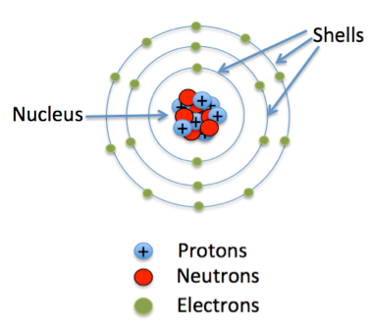
The electrons can only orbit stably in certain orbits ("stationary orbits") at a certain discrete set of distances from the nucleus
These orbits are associated with definite energies and are also called energy levels or shells
In these orbits, the electrons do not radiate
Electrons can jump from one allowed orbit to another, gaining or losing energy
When an electron changes its orbit, it absorbs or emit electromagnetic radiation with a frequency ν determined by the energy difference of the levels E=h·ν
Electrons, inside the atom, orbit around the nucleus.
Lesson one
5
6

Slide 4
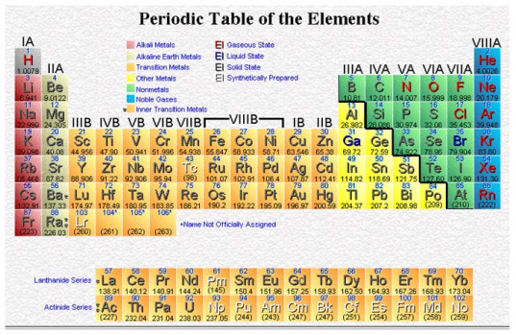

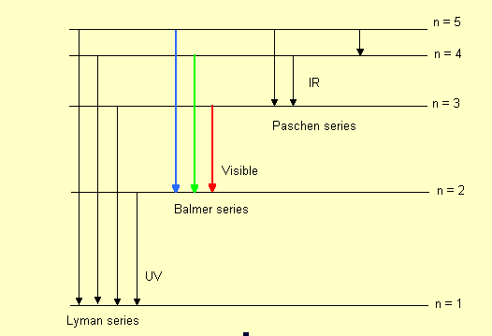
That’s the
element signature!
A single atom
Each different element has a particular set of permitted electronic energies.
Atoms of the same element have exactly the same energy levels.
7
8

Slide 5
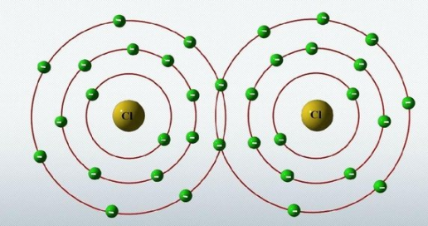
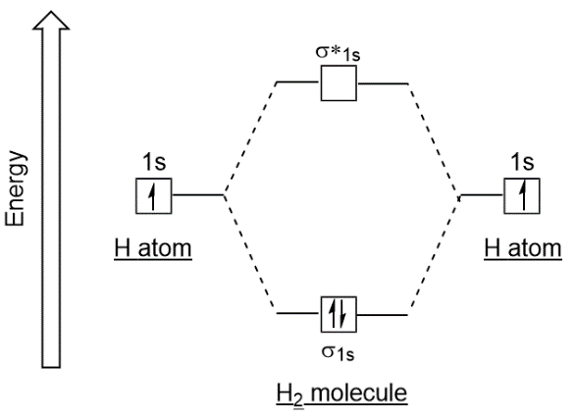
If two atoms of the same element approach each other, the external orbits interact
Owing to the Pauli’s exclusion principle, two electrons can’t occupy the same energy state
As a consequence, each level splits into two
Two atoms
What happens if two atoms approach each other?
9
10

Slide 6
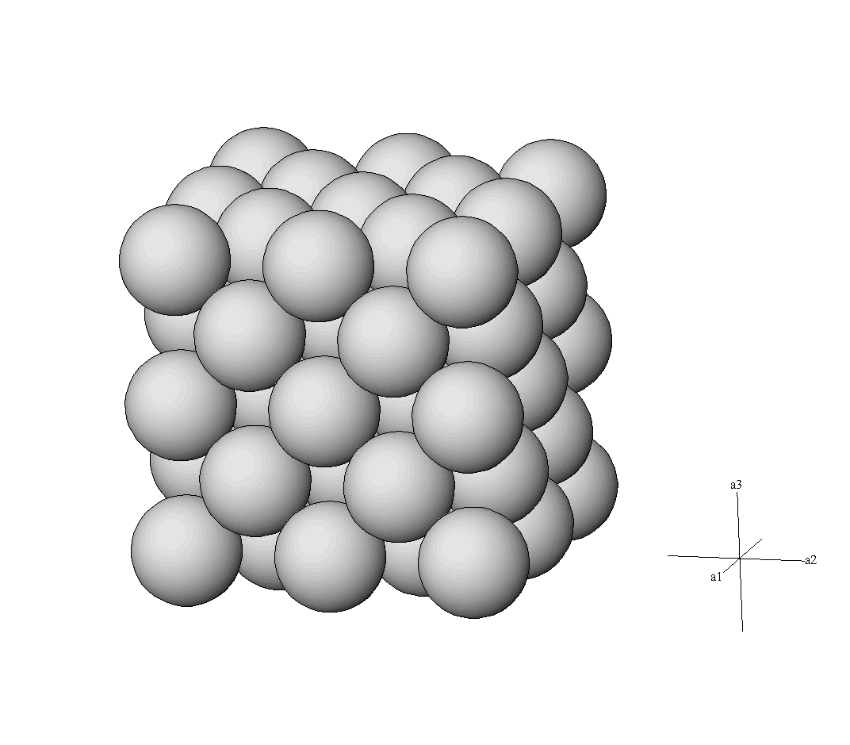
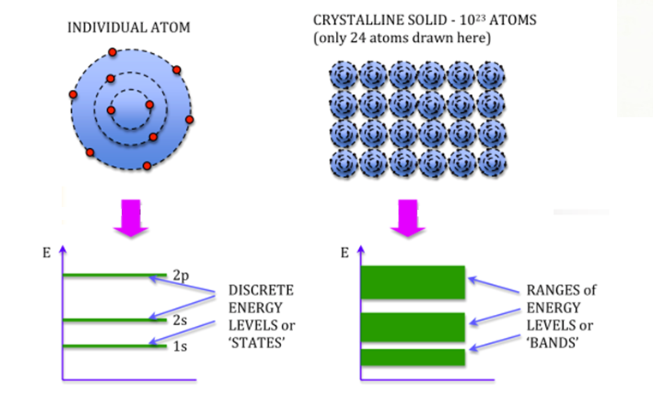
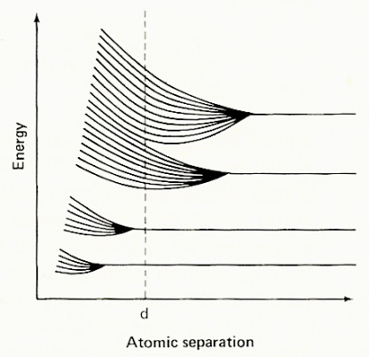
In a crystal lattice, where «n» atoms are close into a tridimentional pattern, each energy level splits into «n» different ones, very similiar in energy
A crystal lattice
What happens if many atoms are very close to each other?
These levels are so near to be considered a continuous band
11
12

Slide 7
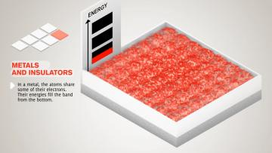
Video:
Conductors
vs
Insulators
What is the difference between conductors and insulators?
We spoke about Conductors and Insulators;
What about Semiconductors?
13
14

Slide 8
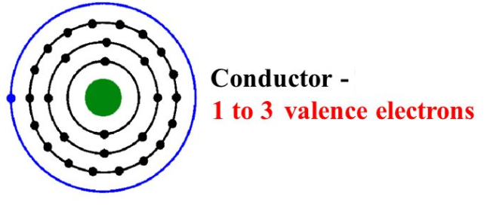
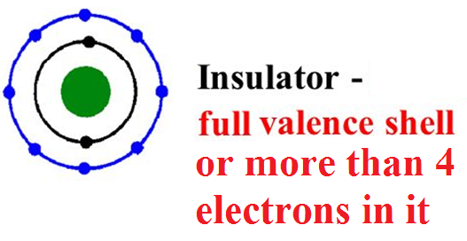

Conductors
Insulators
Semiconductors
Valence level:
the last occupied level
Conduction level:
the first empty level
Conductors : the valence electrons are slightly bound and they can easily be removed by the atom.
What are the differences among
a conductor atom,
an insulator atom and a semiconductor one?
Insulators: the valence electrons are tightly bound and they can’t jump to a conduction level, because they need too much energy.
Semiconductors: the valence electrons can jump in a conduction level if they gain a little energy.
13
14

Slide 9
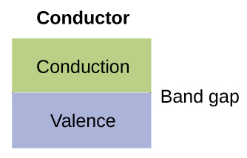
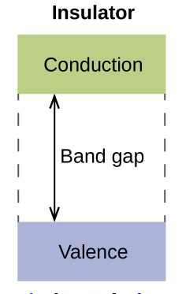

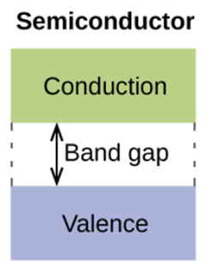
When we consider a bulk of atoms, the atomic energy levels split in a continuous energy band
Conductors
Insulators
Semiconductors
Valence band:
The highest occupied
energy band
Conduction band:
The first empty
energy band
Band Gap:
Forbidden space
Conductors : the conduction band and the valence band are close, sometimes they overlap
The electron can easy jump from the valence band to the conduction one
How these differences affect the band structure of conductors, insulators and semiconductors?
Insulators: the conduction band is very far from the valence band
Only a large amount of energy can send electrons in it
Semiconductors: the conduction band is quite near to the valence one
A little energy is sufficient to send electron in it
13
14

Slide 10
Lesson one
What Is Energy Band Model?
Let’s check
what we learnt:
1
2

